Slide 1

Data driven real estate decisions to maximize ROI
Group 3: Freda, Hidenobu, PiZheng (Grace), Yafan (Violet), Zhiyu (Harden), Jenna

Slide 2
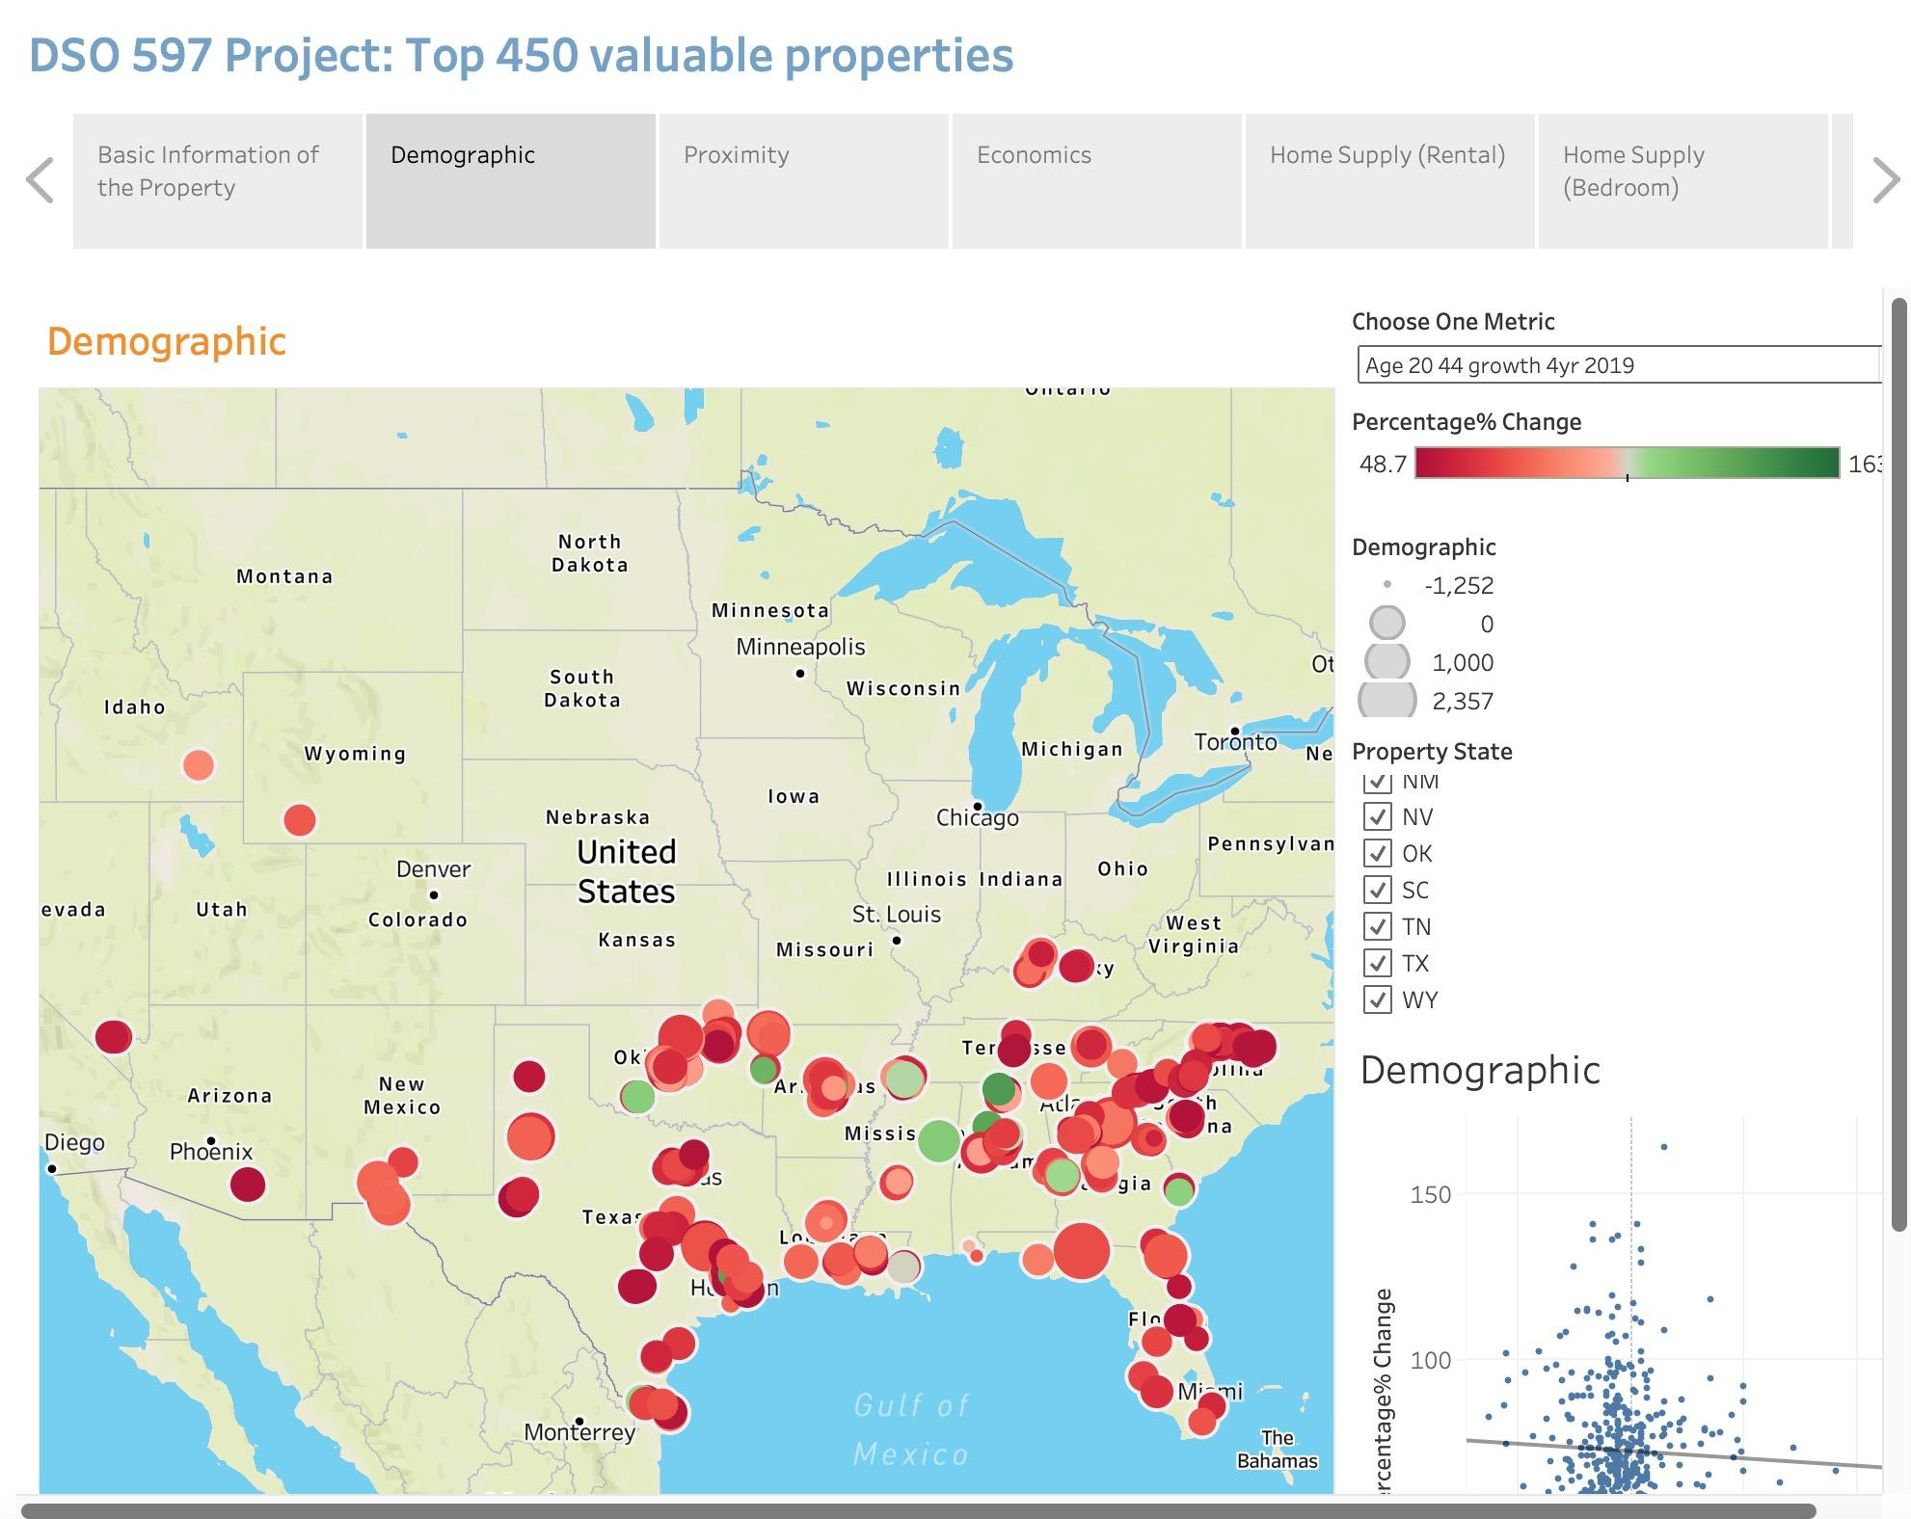
Modeling Process
Data Preparation:
54 variables (demographics, proximity, economic, home supply, etc.)
Data cleaning to remove the outliers
Feature Selection:
Use stepwise regression to keep the top 25 variables
Model Selection:
Lasso, KNN, K-mean, Random Forest models
Final model: Lasso has the highest score (R^2) of 92%
Output:
Tableau workbook of top 450 properties with highest % increase in predicted rent
(Predicted - Current) / Current
Top 5 properties for investment suggestion

Slide 3

Top 5 Properties
Notes:
Percentage change: 140.715605

Slide 4
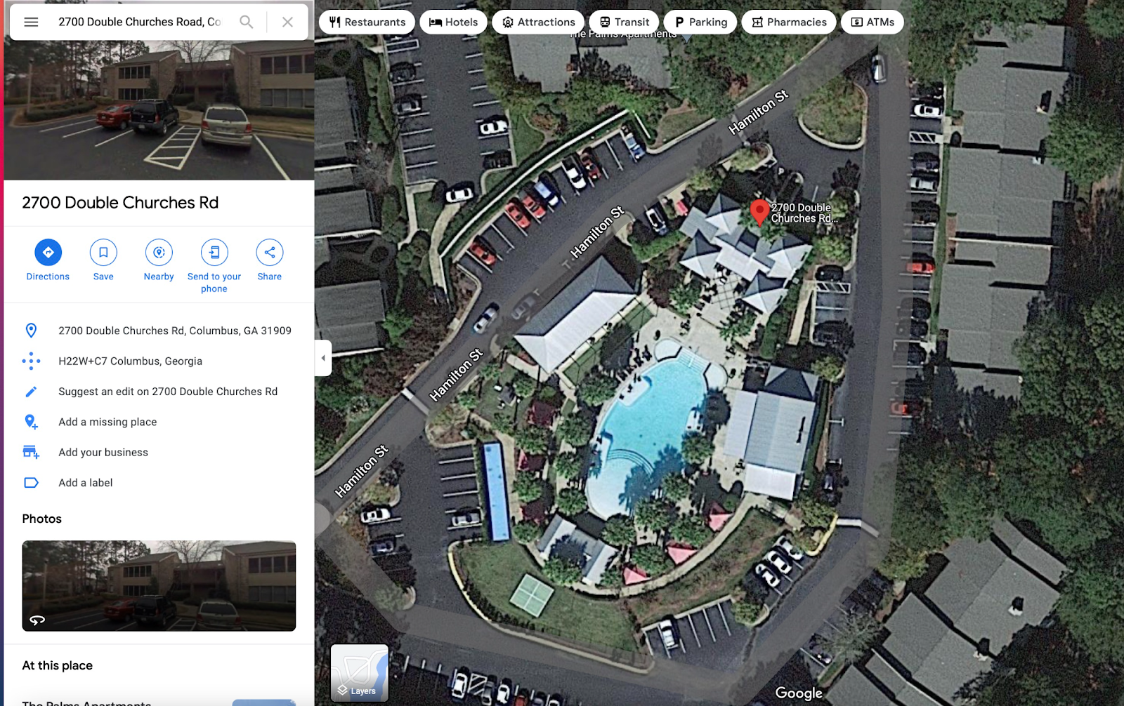
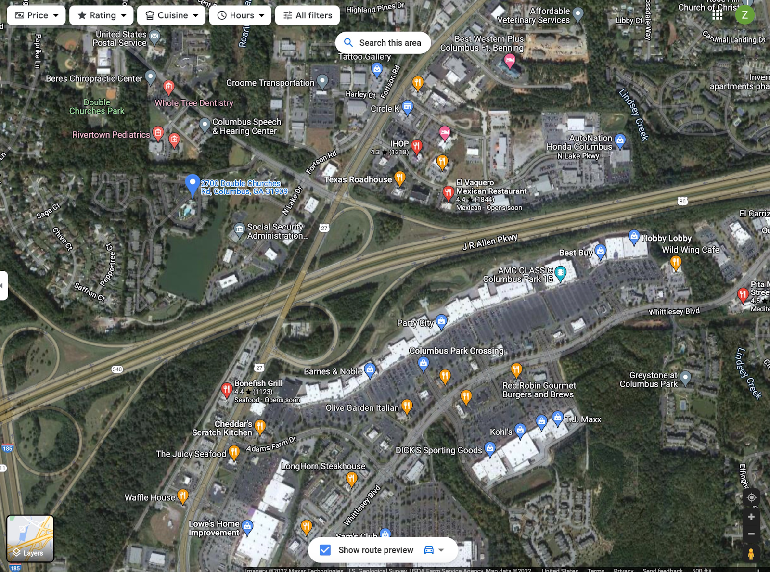
Basic Information：
Property I
Property ID: 127_131 | Current Occupancy: 97.7%
Property Name: The Palms Apartment | Median Rental: $967 /month
Address: 2700 Double Churches Road | Average Home Rent: $708.39/month
Rank: A | Population_2020: 3572
Property Units: 386 | Current Rent per SQFT: 0.7886
Property SQFT: 482650 | Predicted: 1.8374
Date Completed: 1984-01-01 | Rent Percentage Change: 132.80%
Surroundings:
Convenient Transportation;
Shopping malls & restaurants;
Healthcare facilities (pediatrics, dentistry etc.);
Federal facilities;
Recreational places;
Low Crime Rate Nearby;
Amenities:
Swimming Pools & Basketball Court;
Beautiful Landscaping;
Airport Transportation;
High Speed Free Internet Access;
24-hour Courtesy Patrol;

Slide 5
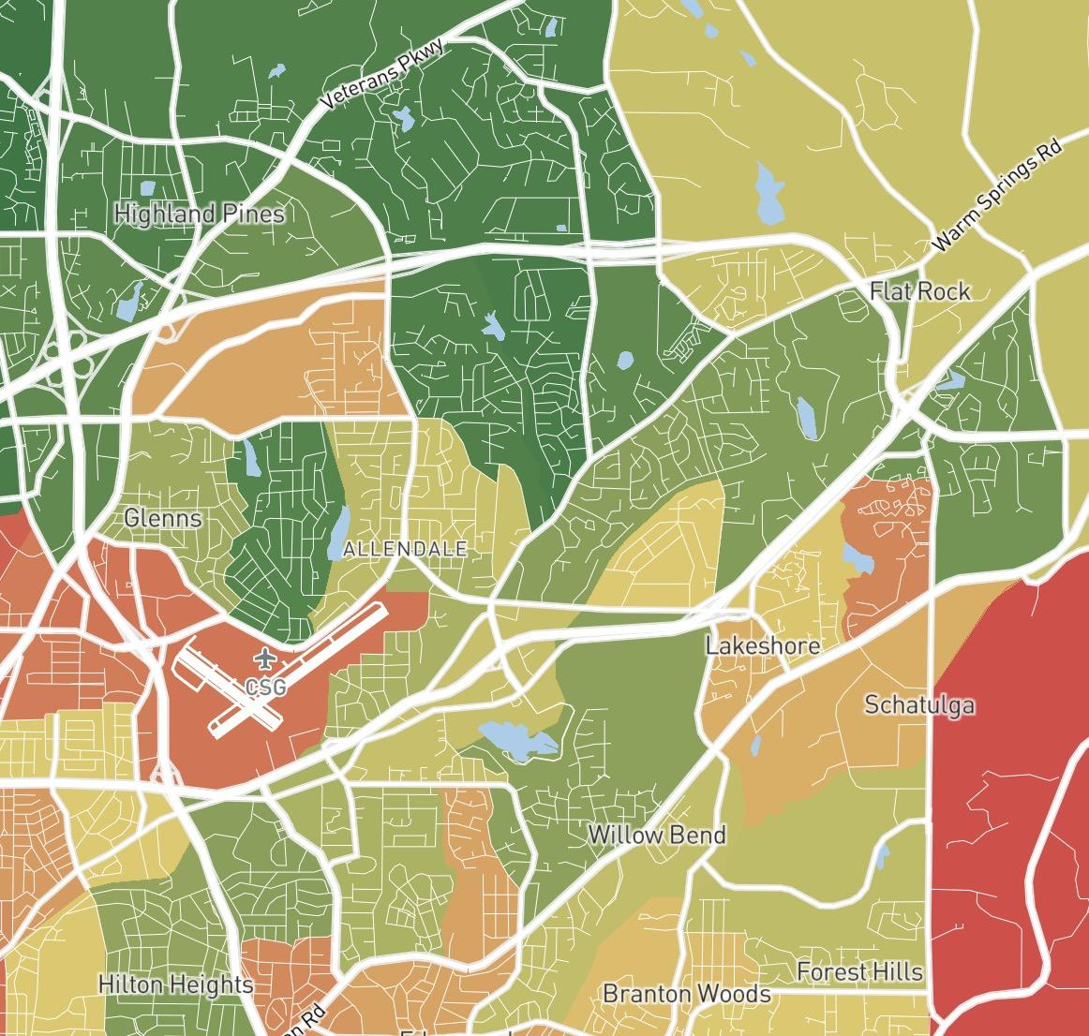
Property I
Average Rent Per Square Feet:
Market Columbus GA, 127: 0.8028
Submarket Columbus – North: 0.8568
County Muscogee: 0.7918
Zip 31909: 0.7980
Property 127_131: 0.7886
Suggestions:
Hire a new management team (Complain about rude management team, do not care anything)
Renew furniture inside the room & Periodically Clean the house

Slide 6
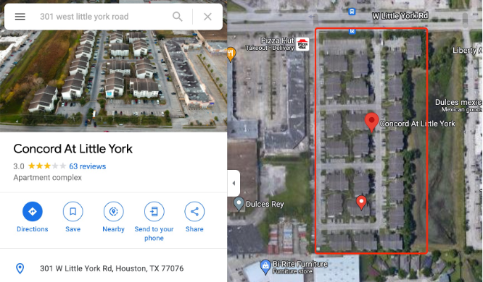
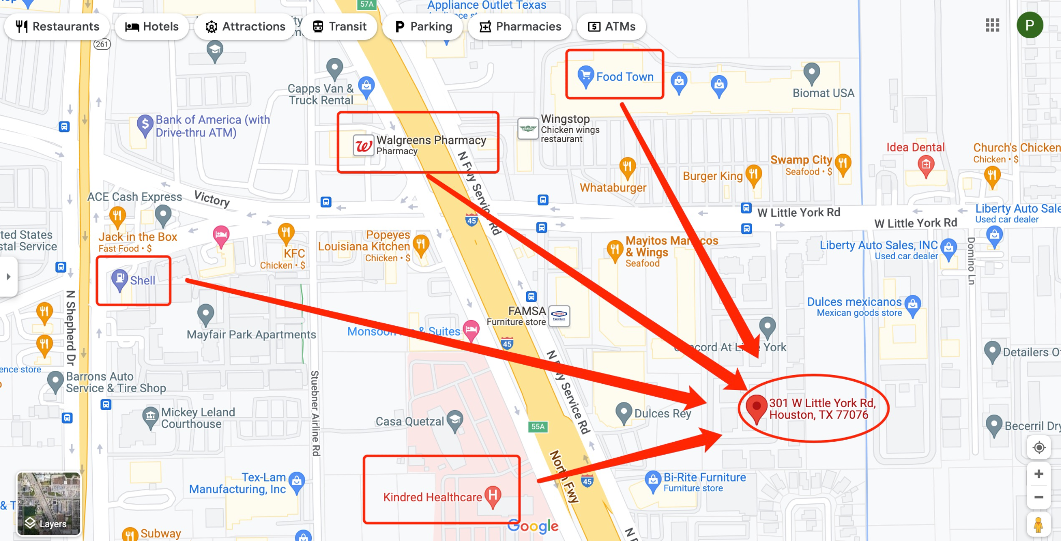
Basic Information：
Property II
Property ID: 62_3358 | Current Occupancy: 83%
Property Name: Concord at Little York | Median Rental: $1097.50 /month
Address: 301 West Little York Road, Houston, TX, 77076 | Average Home Rent: $1009.14/month
Rank: A | Population_2020: 4388.5
Property Units: 276 | Current Rent per SQFT: 0.7751
Property SQFT: 308728 | Predicted: 1.8354
Date Completed: 2001-01-01 | Rent Percentage Change: 136.80%
Surroundings:
Service: bank, postal office etc
1 hospital within 1 mile distance
9 schools available from Start Center to High School
2 parks within 1.5 miles distance

Slide 7
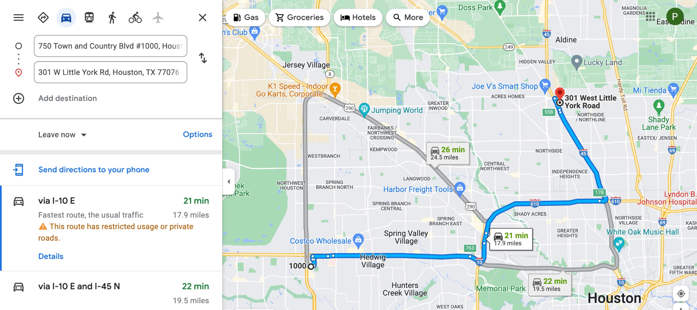
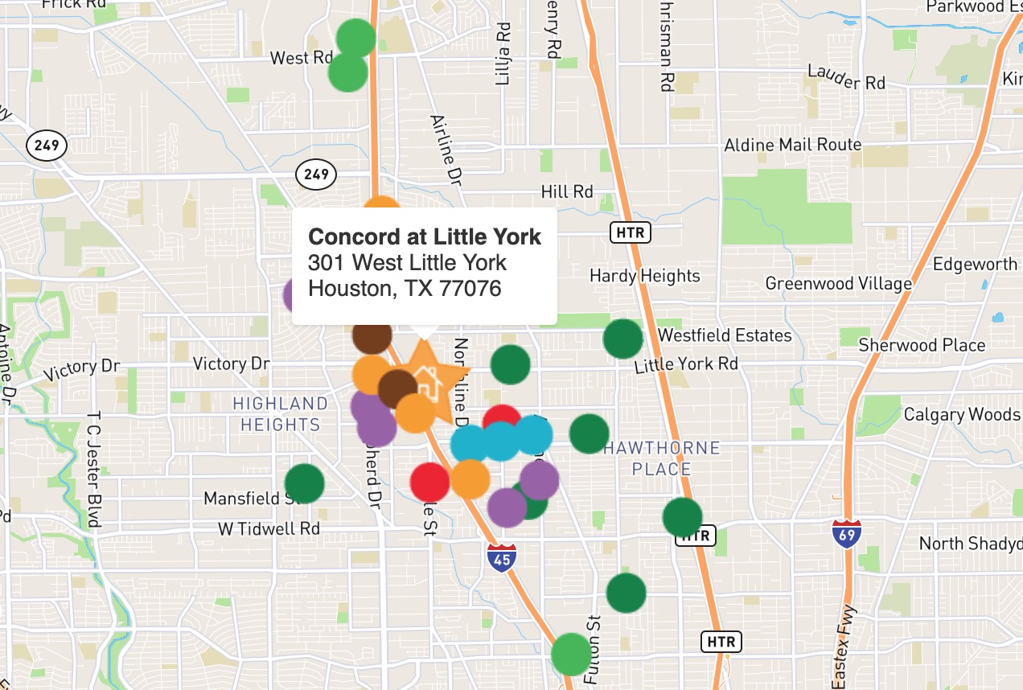
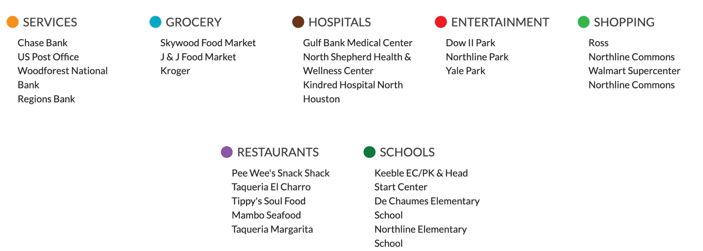
Property II
Property’s most common bedroom model is 2 bedrooms apartment (28.90%) and 3 bedrooms apartment (24.62%).
High medium Income for the area (31,187 dollars). 6.68 percent are considered as tech employees.
Microsoft Corporate Office is 21 minutes driving distance. Aspen Technology is 24 minutes driving distance along with several other tech companies.

Slide 8
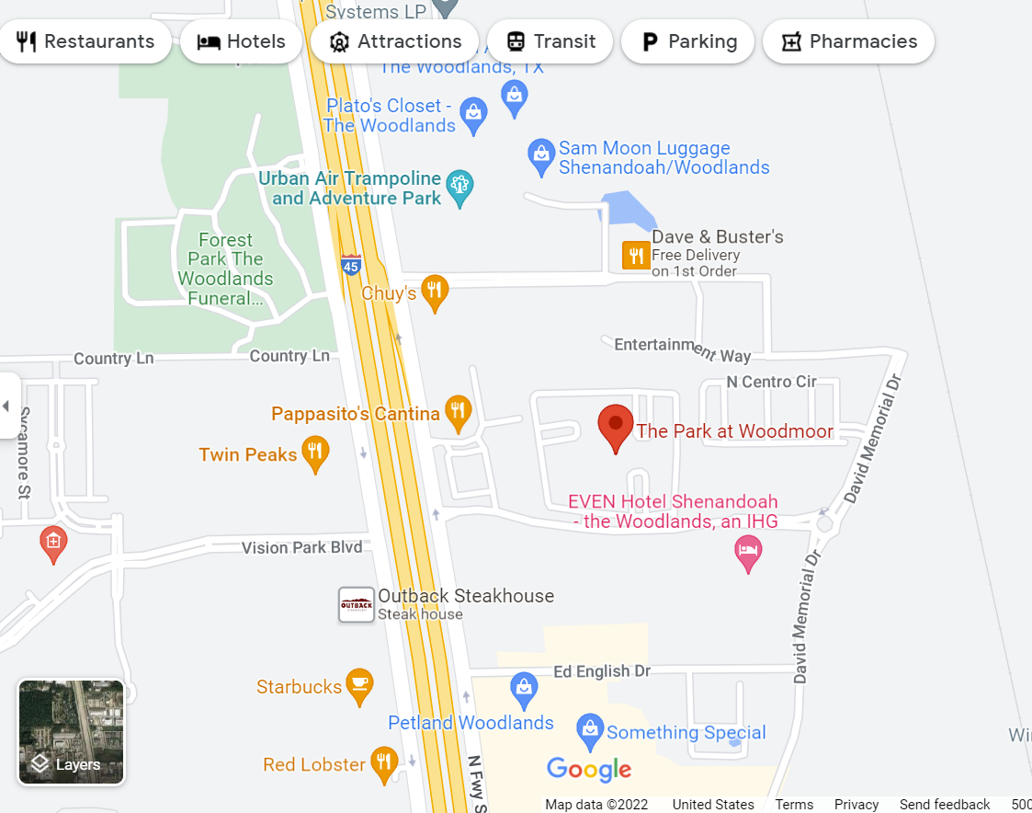
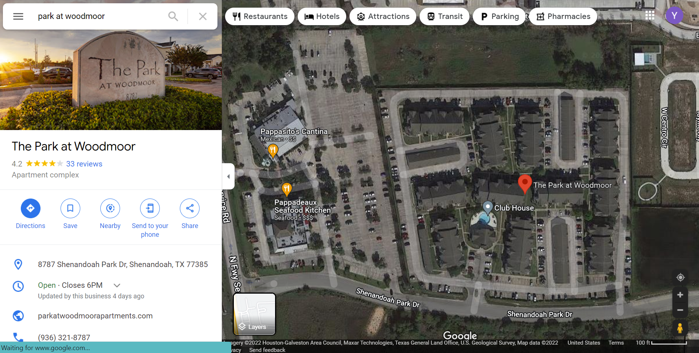
Basic Information：
Property III
Property ID: 62_2259 | Current Occupancy: 89.1%
Property Name: Park at Woodmoor | Current Rent: $1010/month
Address: 8787 Shenandoah Park Drive, Shenandoah, TX, 77385 | Median Rental Paid: $1129 /month
Rank: A / B- | Average Home Rent: $1117.65/month
Property Units: 220 (1 bed - 2 beds) | Current Rent per SQFT: 1.0536
Property SQFT: 308728 | Predicted: 1.8354
Date Completed: 2001-01-01 | Rent Percentage Change: 74.19%
Surroundings:
Many stores and restaurants
2 law enforcement, 11 schools and 9 hospital
Close to I-45 and I-242
Low crime rate
Positive population growth
Nearby multifamily apartments have higher rents
Stone Creek: 1b - 3b $1080 - $2880
Harper’s retreat: 1b - 2b $1260 - $1590
Amenities:
Gym, Swimming Pool, Clubhouse

Slide 9
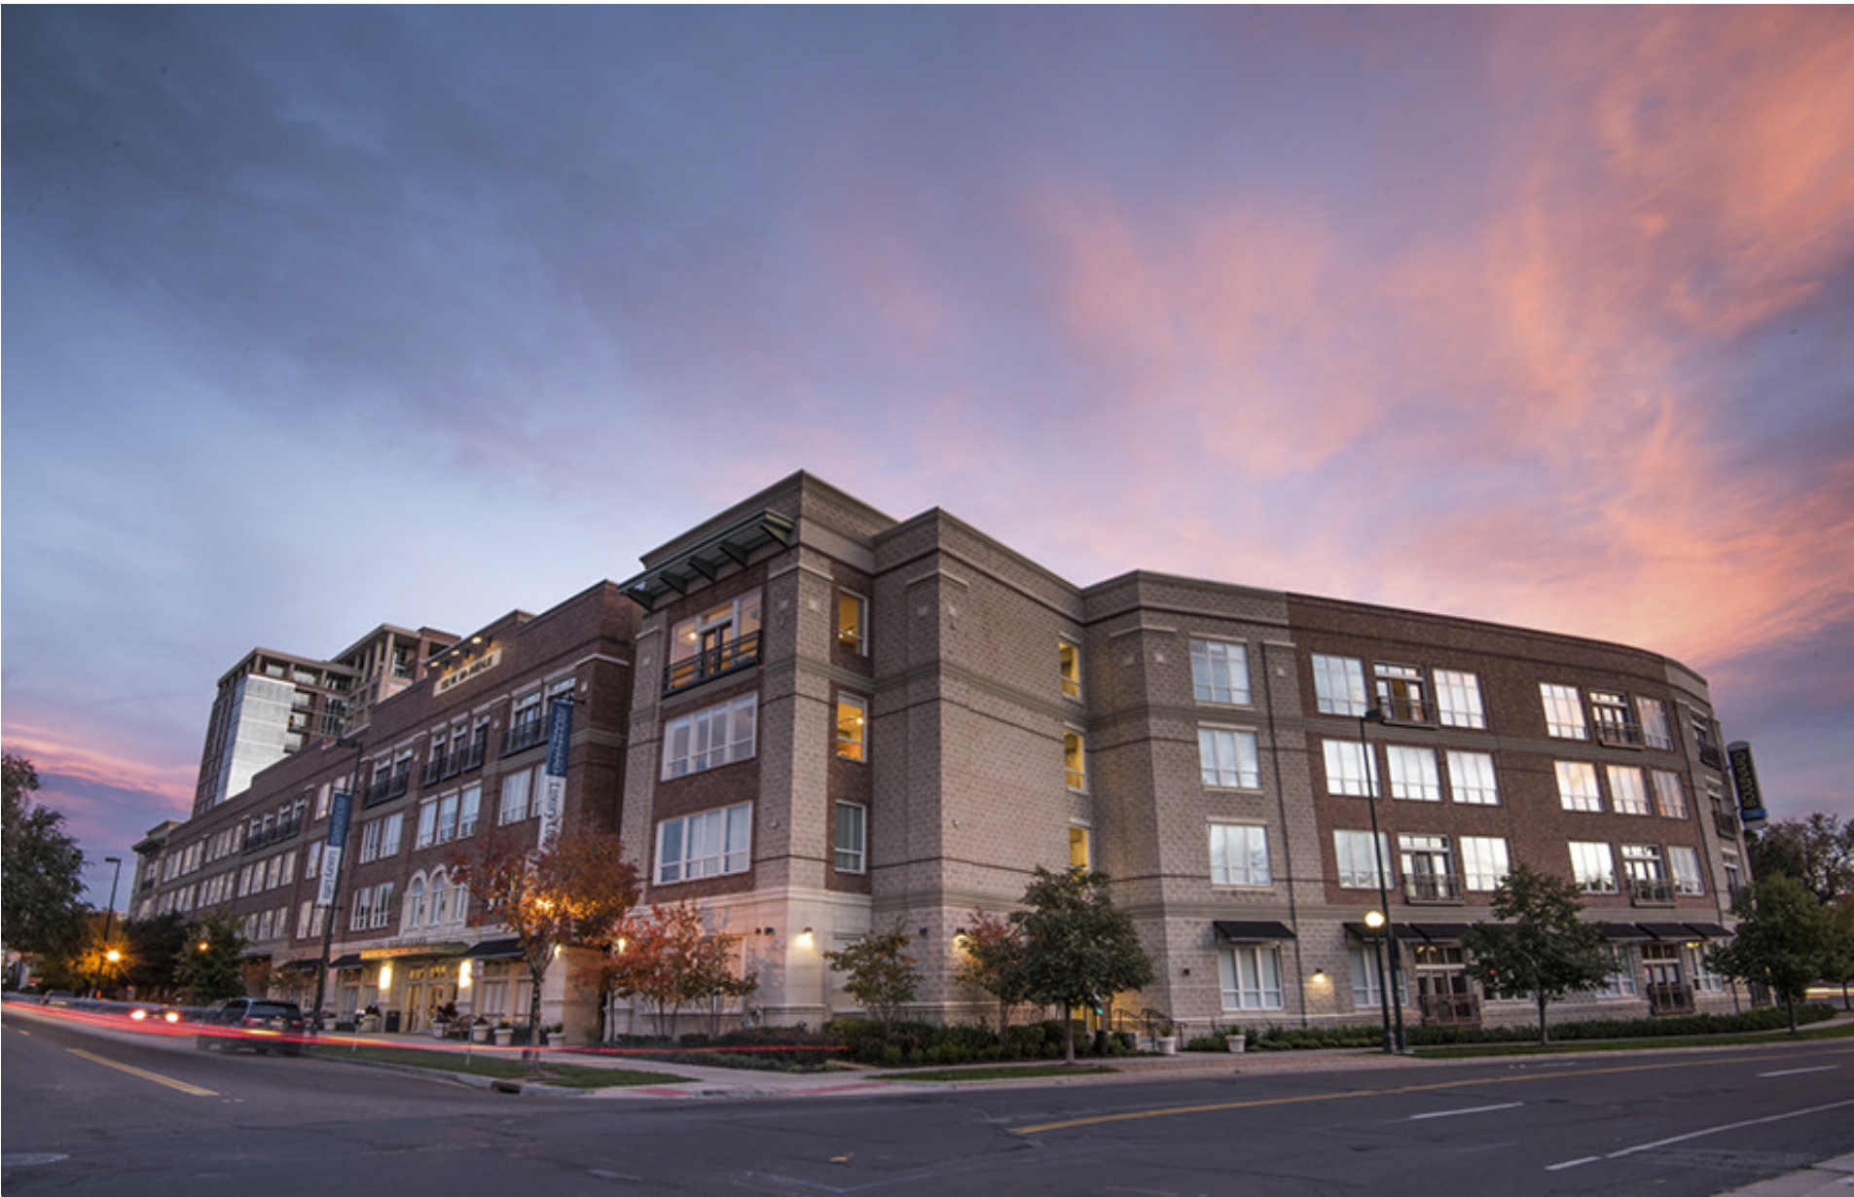
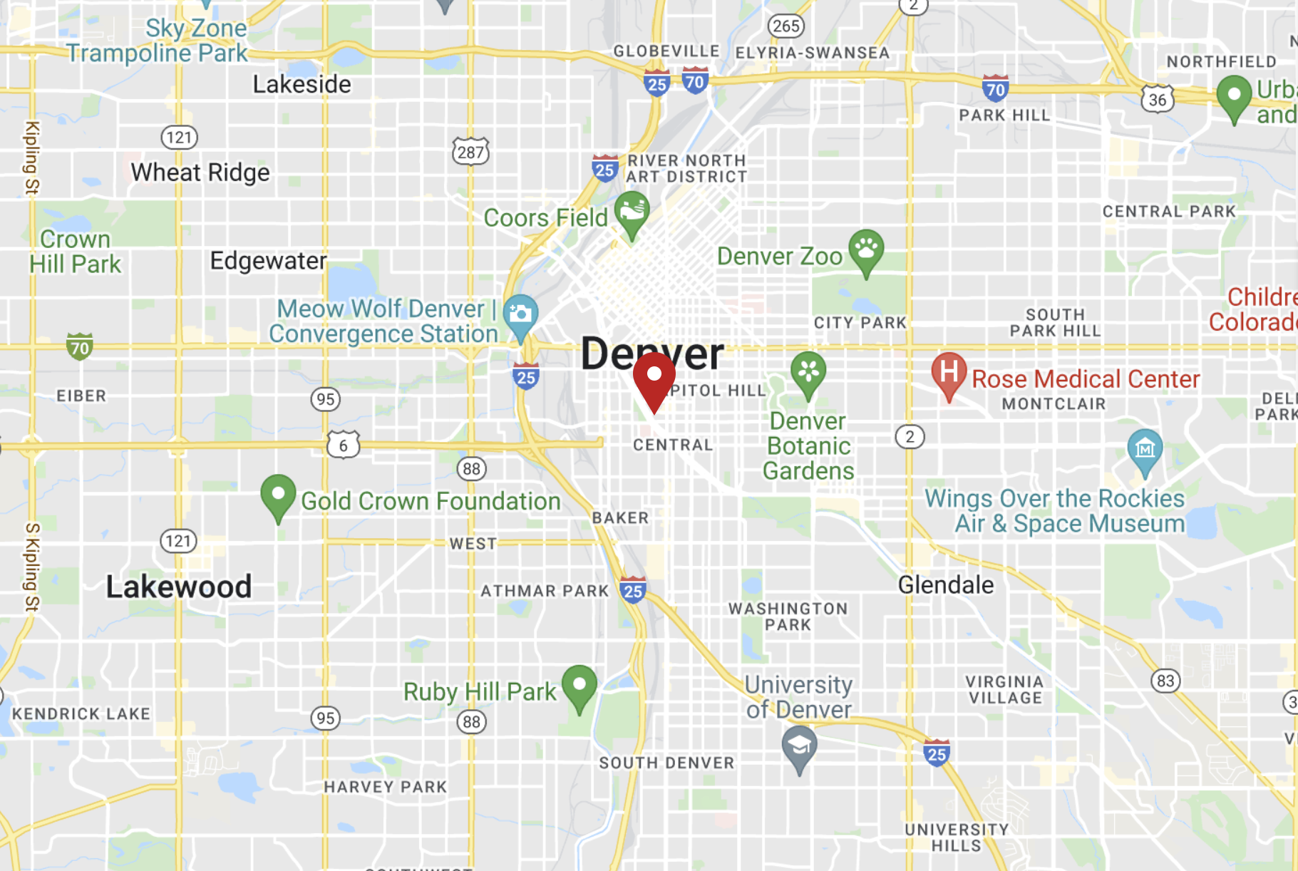
Basic Information：
Property IV
Property ID: 8_6481 | Current Occupancy: 93.8%
Property Name: The Boulevard Lots (Google: Boulevard Apartments) | Current Rent: $1900/month
Address: 150 West 9th Avenue Denver, CO 80204 | Submarket: CBD/Five Points/North Capitol Hill
Rank: A, B- | Census code: 80310020002
Property Units: 290 (bedrooms: studios, 1 bed, 2 bed) | Current Rent per SQFT: 1.91
Property SQFT: 302,338 | Predicted: 3.31
Date Completed: 11/17/2006 | Rent Percentage Change: 73.3%
Characteristics of property location:
High population growth
Bustling neighborhood: # starbucks, schools, markets
Safe: # of law enforcement
High median income
High median home value
Submarket average rent: 2.6
Census Tract | Property | Rent*
2000 | Boulevard Lots | 1675-2665
2000 | 1000 Speer | 1700-6800
2000 | Civic Lots | 1000-1600*
Notes:
High population growth , people moving into the area
Bustling neighborhood: # starbucks (30), schools (42), markets (10)
Safe: # of law enforcement (7), high z-score
High median income ($63,611)
High median home value ($568,600) - people renting for longer, people have money
*rent pulled from apartments.com
Civic lots: only studio + 1 bed, 1000-1600 (apts half sqft of Blvd Apartments)

Slide 10
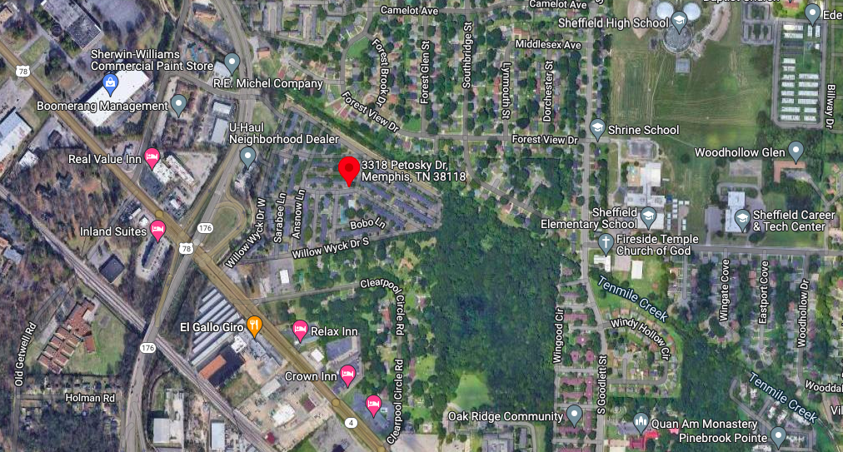
Basic Information：
Property V
Property ID: 92_139 | Current Occupancy: 100%
Property Name: Shadowbrook Townhomes | Median Rental: $559 /month
Address: 3318 Petosky Street, Memphis, TN | Average Home Rent: $556.44/month
Rank: C+ / C | Current Rent: $719/month
Property Units: 366 | Current Rent per SQFT: 0.4991
Property SQFT: 527295 | Predicted: 1.3155
Date Completed: 1972-01-01 | Rent Percentage Change: 163.59%
Surroundings:
Less than 20 min to metropolitan areas of Memphis
18 schools
A Grocery Store
A Law Enforcement

Slide 11
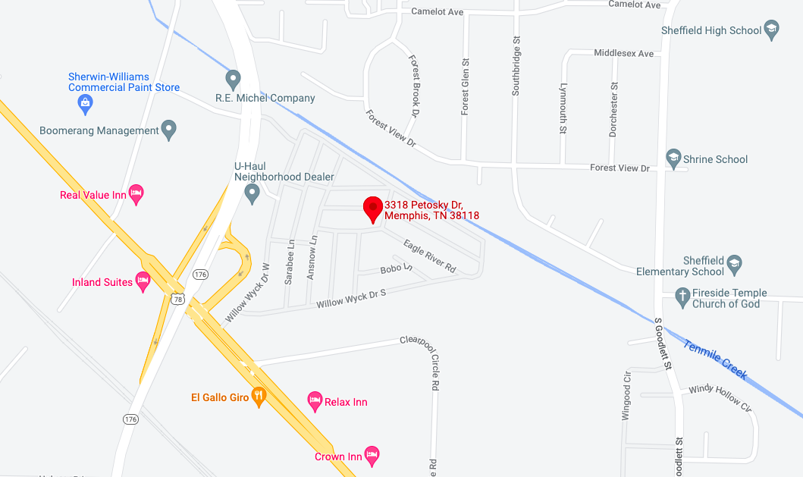
Property V
Other Property Characteristics:
Very large area (top5%) and many units (top17%)
Many units with 100% occupancy rate
No rent paid rate: 0
Demographic Characteristics
Top 10% of 20-44 population growth
Potential Improvement
Security (Crime rate in Memphis is high)
Renewal of property (50 years since completed)

Slide 12

Questions

